Slide 1
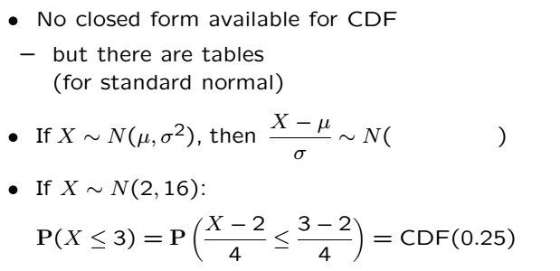

Calculating Normal Probabilities

Slide 2
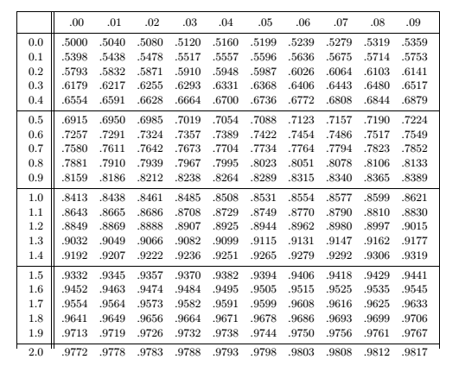
Calculating Normal Probabilities
Tables exist
Can be constructed using numerical methods
No, you don’t have to memorize them!

Slide 3

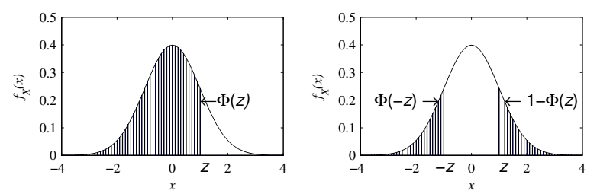
Calculating Normal Probabilities
Let $X$ be Gaussian with mean 61 and std 10; What is $P[X≤46]$
Used in 3rd inequality (see below)

Slide 5
Acknowledgements and Citations
Parts of these slides are adapted from the following resources:
Power Point Lecture Slides for the Textbook http://bcs.wiley.com/hebcs/Books?action=index&bcsId=8676&itemId=1118324560
John Tsitsiklis. 6.041 Probabilistic Systems Analysis and Applied Probability, Fall 2010. (Massachusetts Institute of Technology: MIT OpenCourseWare),http://ocw.mit.edu (Accessed 13 Apr, 2015). License: Creative Commons BY-NC-SA

